Slide 1
LTE Air Interface Basics Primer d

Slide 2
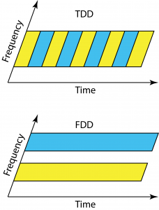
LTE Radio Interface: Radio Access Mode
3GPP radio access for LTE system is designed to operate in two main modes of operation:
FDD (Frequency Division Duplex)
It is the common mode deployed worldwide for LTE
A separate uplink and downlink channel are utilized
Enabling a device to transmit and receive data at the same time.
The spacing between the uplink and downlink channel is referred to as the duplex spacing
The uplink channel operates on the lower frequency
Because higher frequencies suffer greater attenuation than lower frequencies
Therefore, it enables the mobile to utilize lower transmit levels
TDD (Time Division Duplex)
It enables full duplex operation using a single frequency band and time division multiplexing the uplink and downlink signals
Ability to provide asymmetrical UL and DL allocations
Dynamic allocation, increased spectral efficiency, and the improved usage of beamforming techniques
This is due to having the same UL and DL frequency characteristics
Spectrum allocation is also tied to the choice of FDD over TDD

Slide 3
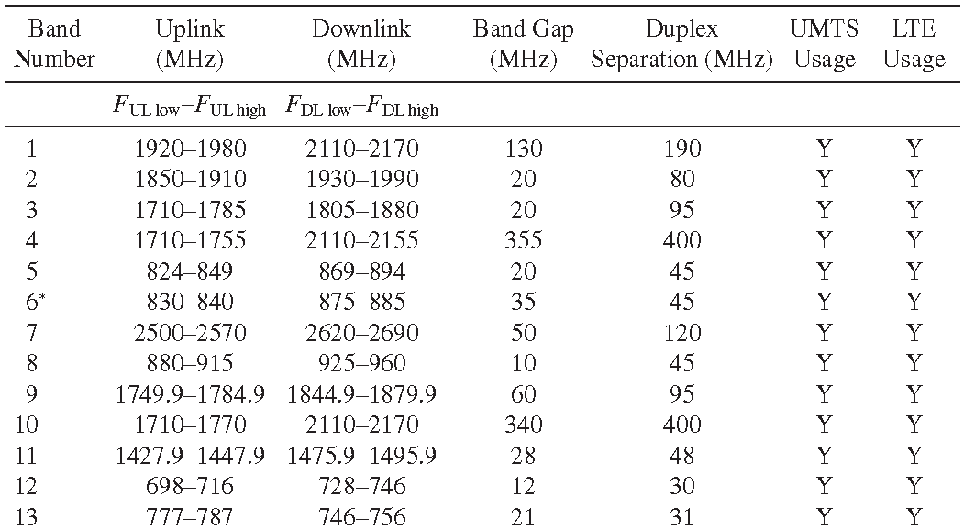
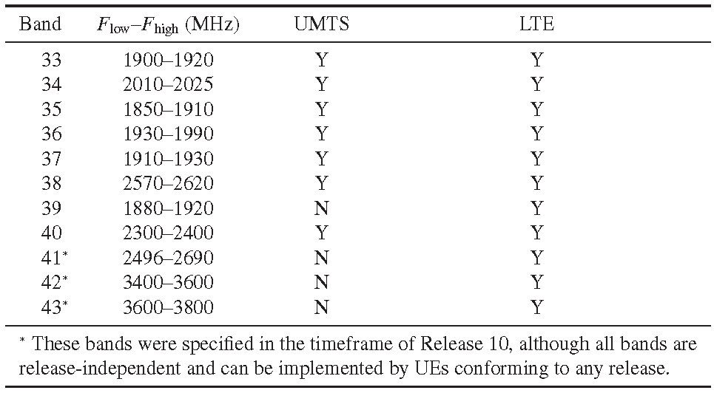
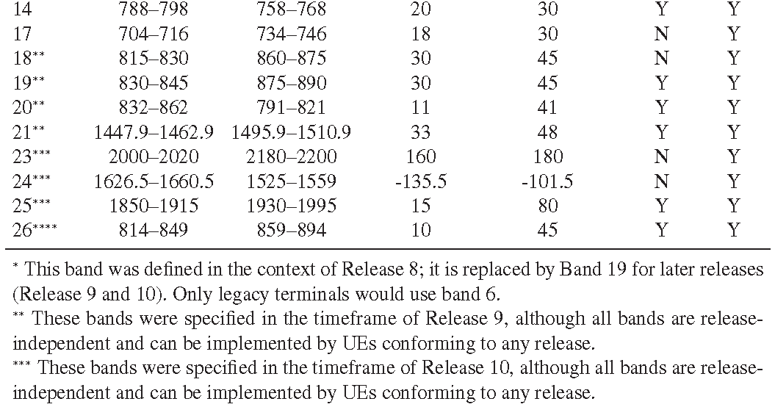
LTE Radio Interface: Spectrum Allocation
LTE uses a variable channel bandwidth of 1.4, 3, 5, 10, 15, or 20 MHz.
Most common worldwide network deployments are in 5 or 10MHz
LTE in 20MHz is being increasingly deployed, especially in bands like 2.6 GHz as well as 1.8 GHz
LTE-FDD requires two center frequencies, one for the downlink and one for the uplink
UMTS and LTE frequency bands for TDD (Rel.10)
UMTS and LTE frequency bands for FDD (Rel.10)

Slide 4
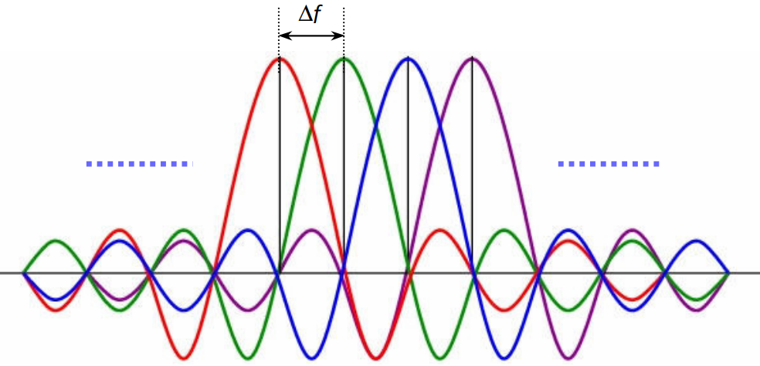
LTE Radio Interface: OFDM
OFDM (Orthogonal Frequency-Division Multiplexing) is the transmission scheme used for 3GPP LTE
OFDM is a special form of multicarrier modulation (MCM) with densely spaced subcarriers with overlapping spectra, thus allowing multiple-access
OFDM systems break the available bandwidth into many narrower sub-carriers and transmit the data in parallel streams
Each subcarrier is modulated using varying levels of QAM modulation
Each OFDM symbol is therefore a linear combination of the instantaneous signals on each of the sub-carriers in the channel
There are two truly remarkable aspects of OFDM
Each OFDM symbol is preceded by a cyclic prefix (CP), which is used to effectively eliminate ISI (Inter Symbol Interference)
The sub-carriers are very tightly spaced to make efficient use of available bandwidth
OFDM Subcarrier Spacing

Slide 5
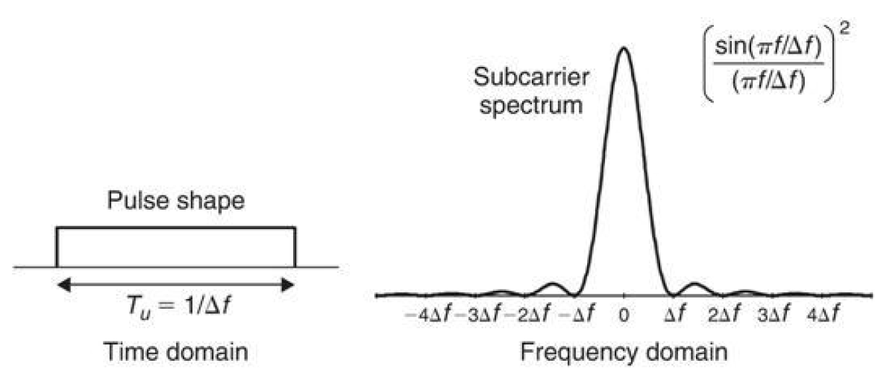
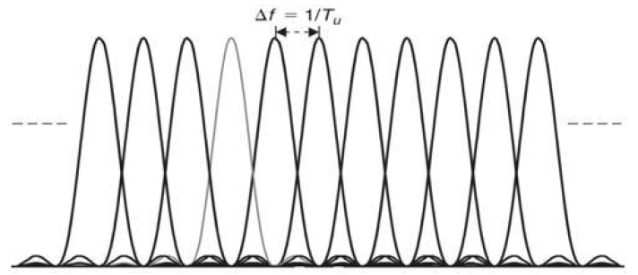
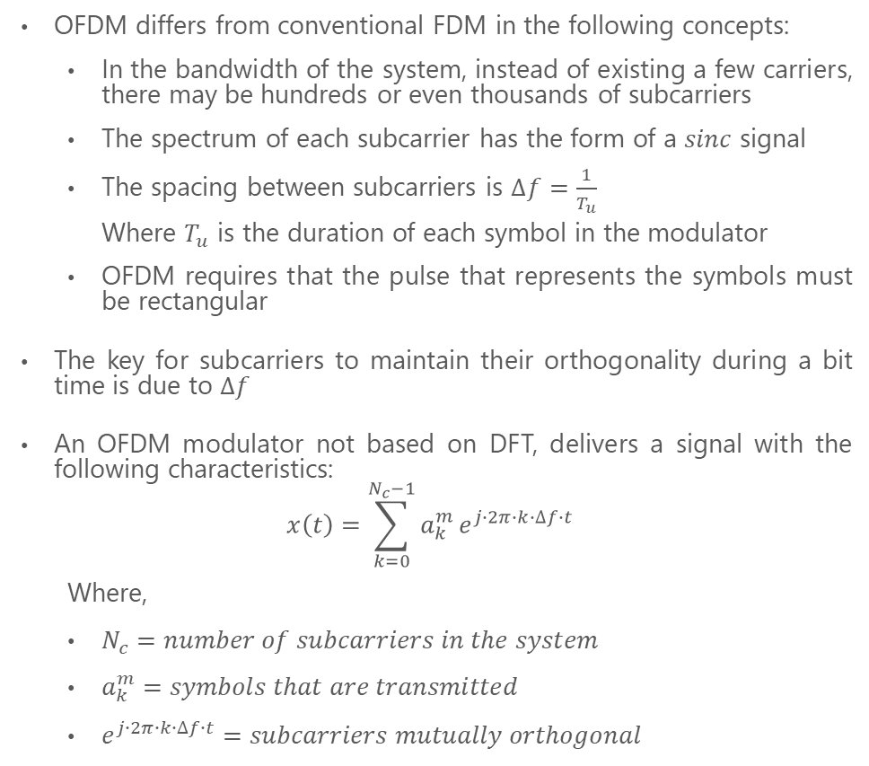
LTE Radio Interface: OFDM
OFDM differs from conventional FDM in the following concepts:
In the bandwidth of the system, instead of existing a few carriers, there may be hundreds or even thousands of subcarriers
The spectrum of each subcarrier has the form of a $sinc$ signal
The spacing between subcarriers is $∆f=\frac{1}{T_{u}}$
Where $T_{u}$ is the duration of each symbol in the modulator
OFDM requires that the pulse that represents the symbols must be rectangular
The key for subcarriers to maintain their orthogonality during a bit time is due to $∆f$
An OFDM modulator not based on DFT, delivers a signal with the following characteristics:
$$x\left(t\right)=\sum_{k=0}^{N_{c}−1}{a_{k}^{m}}e^{j∙2π∙k∙∆f∙t}$$
Where,
$N_{c}=number of subcarriers in the system$
$a_{k}^{m}=symbols that are transmitted$
$e^{j∙2π∙k∙∆f∙t}=subcarriers mutually orthogonal$

Slide 6
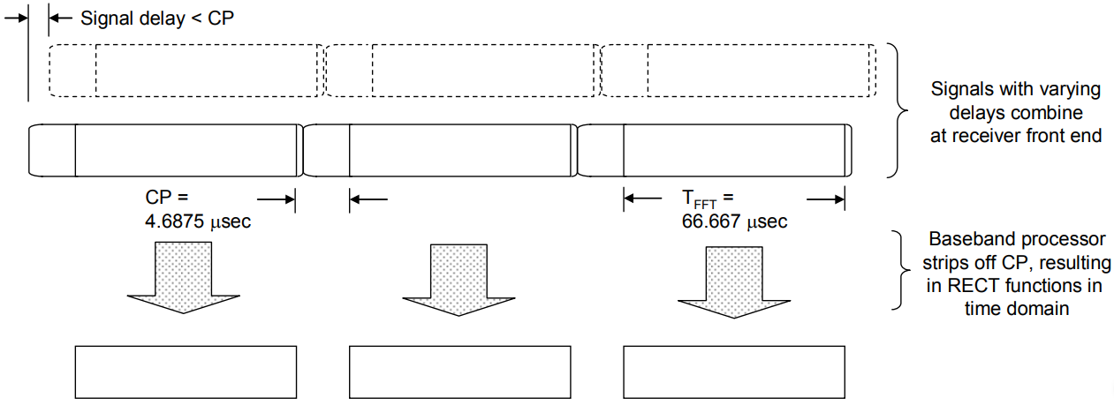
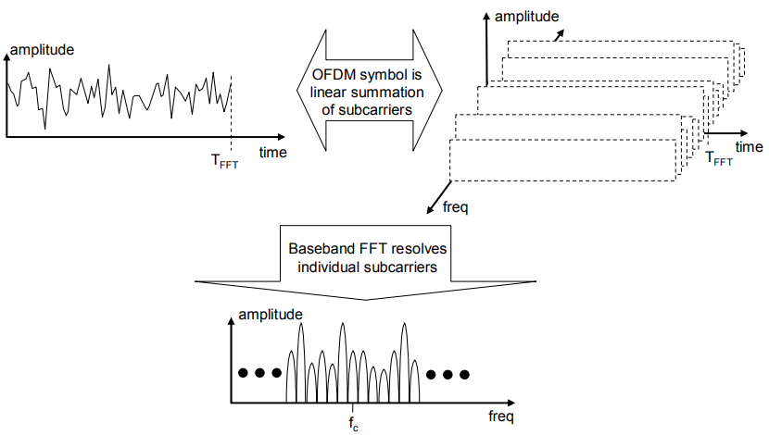
LTE Radio Interface: OFDM
To understand how OFDM deals with ISI induced by multipath, consider the time domain representation of an OFDM symbol (Fig A)
The OFDM symbol consists of two major components:
The CP
FFT period (TFFT)
When transmitted signals arrive at the receiver by two paths of differing length, they are staggered in time (Fig. B)
The duration of the CP is determined by the highest anticipated degree of delay spread for the targeted application
All of the information of relevance to the receiver is contained within the FFT period
Once the signal is received and digitized, the receiver simply throws away the CP
The result is a rectangular pulse that, within each subcarrier, is of constant amplitude over the FFT period
The rectangular pulses resulting from decimation of the CP are central to the ability to space subcarriers very closely in frequency without creating ICI
Fig A. OFDM Eliminates ISI via Longer Symbol Periods and a Cyclic Prefix
Fig B. FFT of OFDM Symbol Reveals Distinct Subcarriers

Slide 7
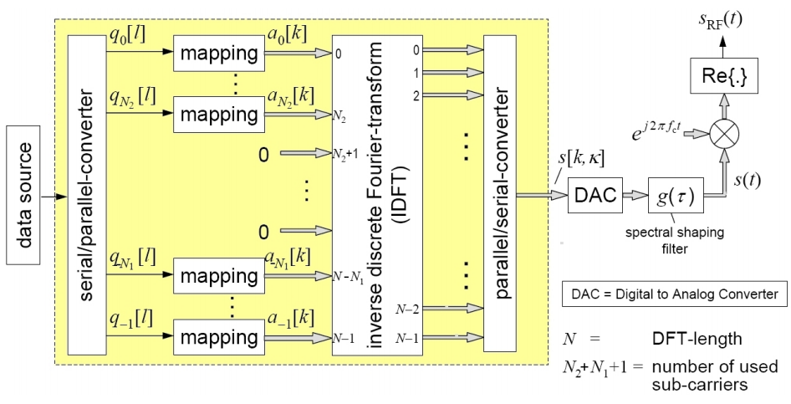
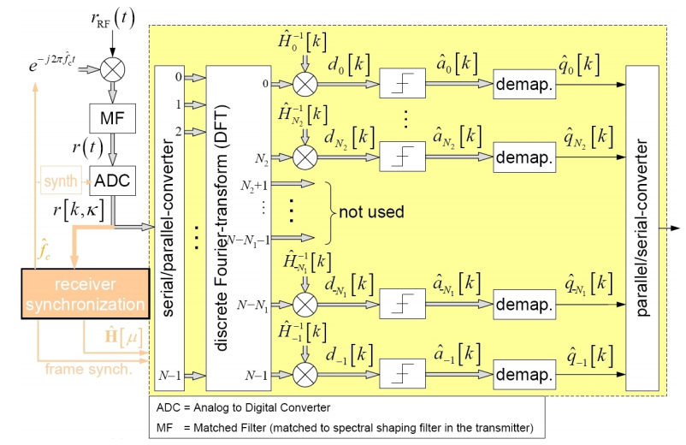
LTE Radio Interface: OFDM
OFDM Transmitter based on IDFT
S/P Converter: Data symbols coming from earlier modules, e.g. channel encoder, are parallelized
Mapping: Maps the incoming symbols on complex-valued samples (QAM Modulation)
IDFT: To get the time domain samples
P/S Converter: Data serialization
DAC: Converts the signal from digital to analog form
Spectral shaping filter: Filter out the shoulders of the OFDM signal which produce out-of-band emissions
Mixer & Local Oscillator: Mixes the generated signal from baseband into the RF domain
OFDM Receiver based on DFT
Matched Filter (MF): Matched to spectral shaping in the transmitter
ADC: Converts the signal from analog to digital
S/P Converter: Data is parallelized
DFT: To get the frequency domain
Equalization: Assuming a frequency-selective channel the equalization in the receiver is simply done by multiplying the samples with the inverse of the corresponding channel coefficients
Decision Module: Hard decision slicer
Demapping: Recovers the bits from symbol delivered by the decision module
P/S Converter: The bits are finally converted from parallel to serial form
OFDM transmitter based on IDFT
OFDM receiver based on DFT

Slide 8
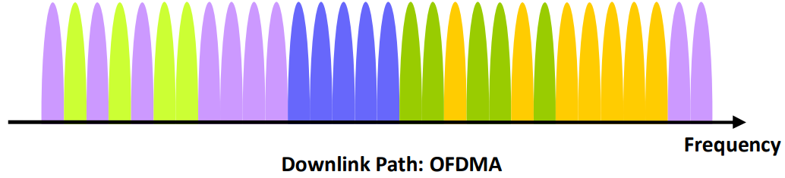
LTE Radio Interface: OFDM
There are many advantages to using OFDM in a mobile access system, namely:
Long symbol time and guard interval increases robustness to multipath and limits inter-symbol interference
Eliminates the need for intra-cell interference cancellation
Allows flexible utilization of frequency spectrum
Increases spectral efficiency due to orthogonality between sub-carriers
Allows optimization of data rates for all users in a cell by transmitting on the best (i.e. non-faded) subcarriers for each user
The increased symbol duration makes an OFDM system more sensitive to the time variations of mobile radio channels.
In particular, the effect of Doppler spreading destroys the orthogonality of the sub-carriers, resulting in ICI due to power leakage among subcarriers
The occurrence of Doppler shift makes the wireless channel fast-time variant and frequency selective
Affecting synchronization, channel estimation and data recovery
The Doppler Effect is tremendously important and one of the most distinct phenomena when dealing with OFDM systems where a small amount of frequency variation can cause a significant degradation in overall performance.
The DL physical layer of LTE is based on OFDMA
OFDM technology to multiplex traffic by allocating specific patterns of sub-carriers in the time-frequency space to different users

Slide 9
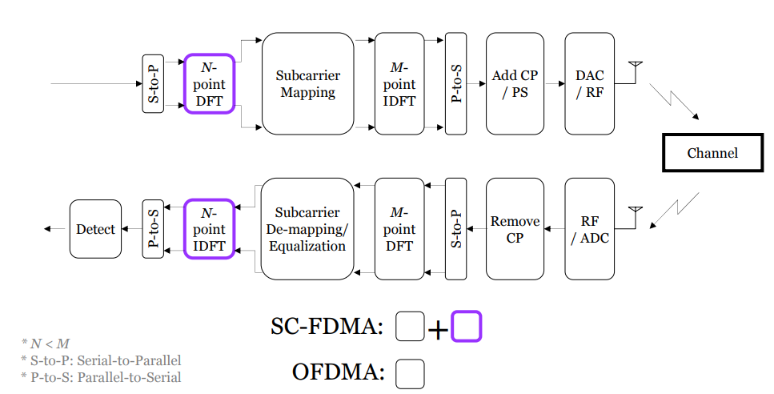
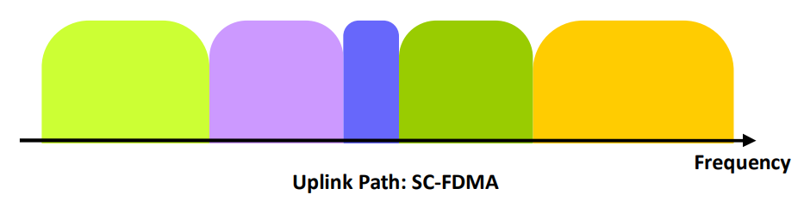
LTE Radio Interface: SC-FDMA
SC-FDMA is currently adopted as the uplink multiple access scheme in 3GPP LTE
It has similar structure and performance to OFDMA
Similar to OFDMA, SC-FDMA divides the transmission bandwidth into multiple parallel subcarriers maintaining the orthogonality of the subcarriers by the addition of the cyclic prefix (CP) as a guard interval
In SC-FDMA the data symbols are not directly assigned to each subcarrier independently like in OFDMA
Instead, the signal which is assigned to each subcarrier is a linear combination of all modulated data symbols transmitted at the same time instant
The difference of SC-FDMA transmission from the OFDMA transmission which is an additional DFT block before the subcarrier mapping
SC-FDMA system is not a multi-carrier but a single-carrier system

Slide 10
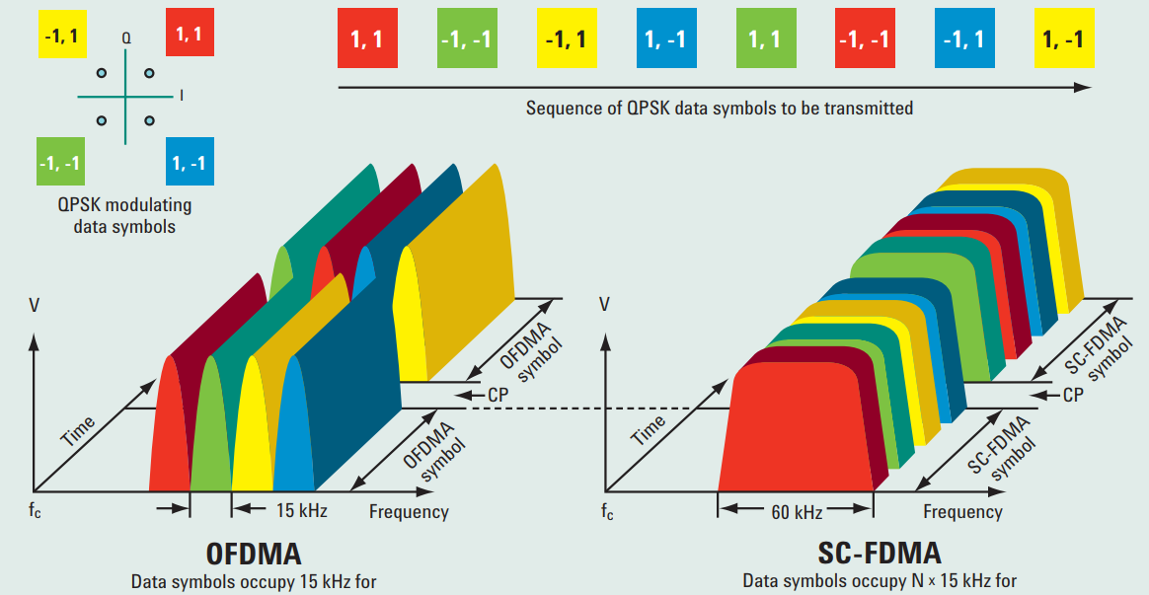
LTE Radio Interface: OFDMA vs SC-FDMA

Slide 11
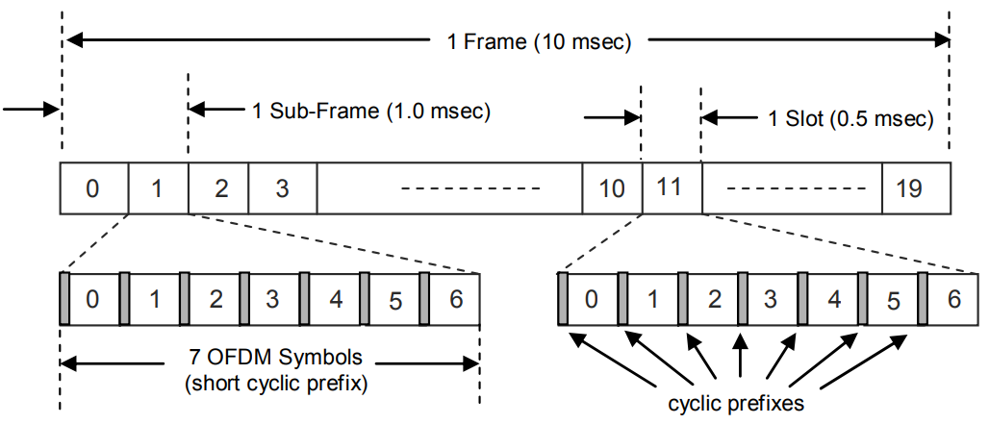
LTE Radio Interface: LTE Frame Structure
One element shared by the LTE DL and UL is the generic frame structure
LTE transmissions are segmented into frames, which are 10 msec in duration
Frames consist of 20 slot periods of 0.5 msec
Sub-frames contain two slot periods and are 1.0 msec in duration
Each Slot transmits 7 OFDM symbols
Normally in very large cells, a structure of 6 symbols per slot is implemented, in order to compensate for multipath propagation
Each frame is divided into ten equally sized subframes of 1 ms in length
Scheduling is done on a subframe basis for both the downlink and uplink
LTE FDD Generic Frame Structure

Slide 12
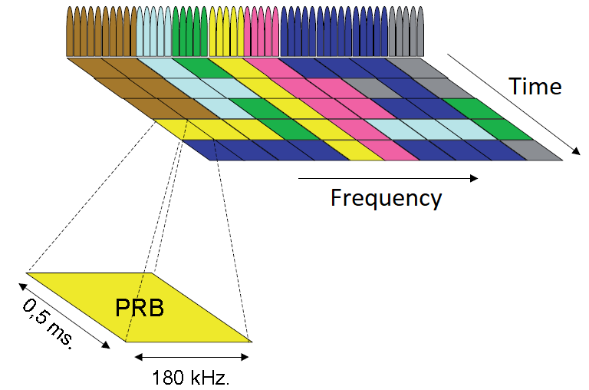
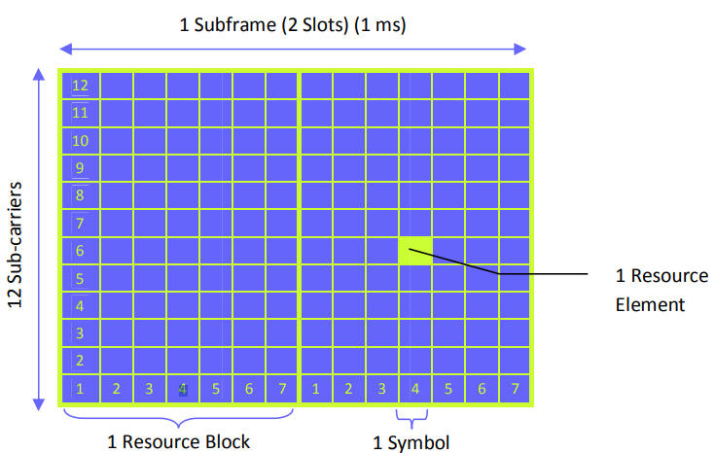
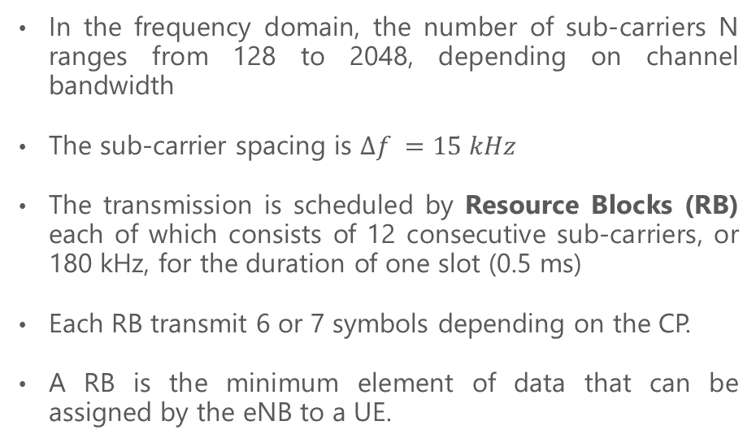
LTE Radio Interface: RB Concept
In the frequency domain, the number of sub-carriers N ranges from 128 to 2048, depending on channel bandwidth
The sub-carrier spacing is $∆f =15 kHz$
The transmission is scheduled by Resource Blocks (RB) each of which consists of 12 consecutive sub-carriers, or 180 kHz, for the duration of one slot (0.5 ms)
Each RB transmit 6 or 7 symbols depending on the CP.
A RB is the minimum element of data that can be assigned by the eNB to a UE.

Slide 13
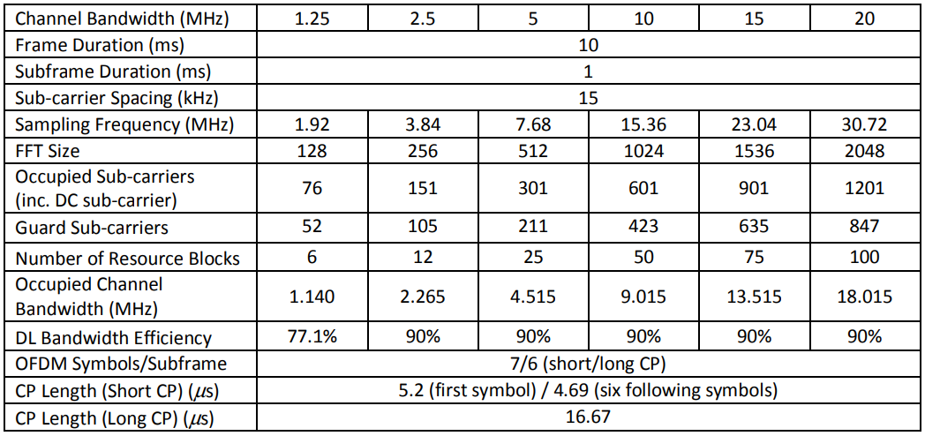
LTE Radio Interface: Physical Layer Parameters
Parameter | Value
Frequency Bands | 700 MHz to 2.5 GHz
Duplexing | FDD, TDD
Channel BW | 1.4 to 20 MHz
Modulation | QPSK, 16QAM, 64QAM
Channel Coding | Turbo coding
Mobility | 350 km/h
Multiple Access | Downlink: OFDMA Uplink: SC-FDMA
Subcarrier Spacing | 15 kHz
Symbol Duration | 66.67 us
CP duration | Normal: 5.2 us first symbol in each slot. 4.69 us all other symbols
 | Extended: 16.67 us
Slot Duration | 0.5 ms
Symbols per slot | Normal CP: 7 Extended CP: 6
Subframe Duration | 1 ms
PRB | 12 subcarriers (180 kHz) during one slot
Frame Duration | 10 ms
LTE FDD downlink physical layer parameters

Slide 14
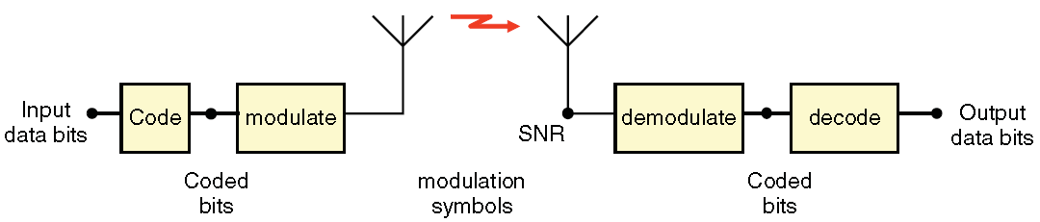
LTE Radio Interface: Modulation and Coding Scheme and Link Adaptation
Throughput over a radio link is the number of data bits that can be successfully transmitted per modulation symbol
Coding (more specifically, forward error correction) adds redundant bits to the data bits, which can correct errors in the received bits
The degree of coding is determined by its rate, the proportion of data bits to coded bits (typically varies from 1/8th to 4/5th)
Coded bits are then converted into modulation symbols
The order of the Modulation determines the number of coded bits that can be transmitted per modulation symbol
Typical examples are QPSK, 16QAM, and 64QAM which have 2, 4, 8 bits per modulation symbol, respectively
Coding and modulation for transmission of data over a radio link

Slide 15
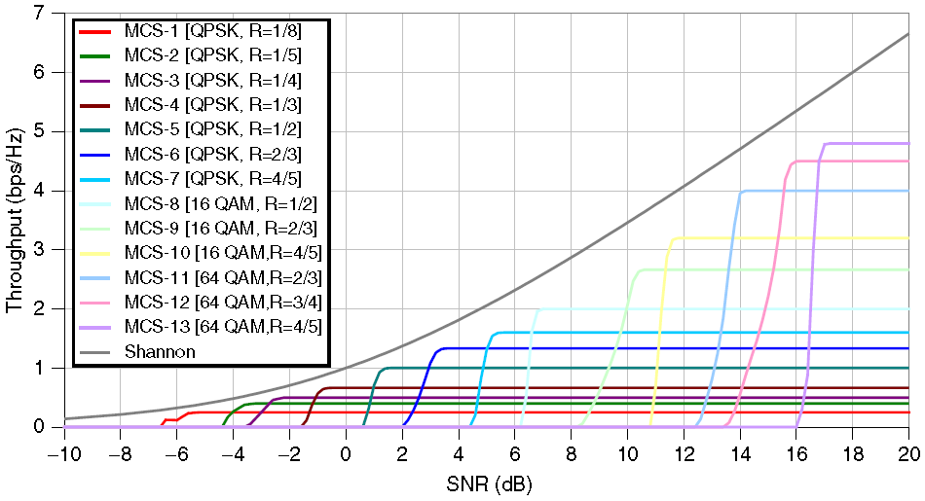
LTE Radio Interface: Modulation and Coding Scheme and Link Adaptation
A given Modulation and Coding Scheme (MCS) requires a certain SNIR (measured at the receiver antenna) to operate with an acceptably low BER in the output data
An MCS with a higher throughput needs a higher SNIR to operate
The efficiency of a given MCS is the product of the rate and the number of bits per modulation symbol
Throughput is commonly normalized to a channel of unity bandwidth, which carries one symbol per second.
So, the units of efficiency then become bps/Hz
Adaptive Modulation and Coding (AMC) works by measuring and feeding back the channel SNIR to the transmitter, which then chooses a suitable MCS from a “codeset” to maximize throughput at that SNIR and to maintain a target BER.
A codeset contains many MCSs and is designed to cover a range of SNRs.
Throughput of a set of coding and modulation combinations (“codeset”), AWGN channels assumed
The Shannon bound represents the maximum theoretical throughput that can be achieved over an AWGN channel for a given SINR

Slide 16
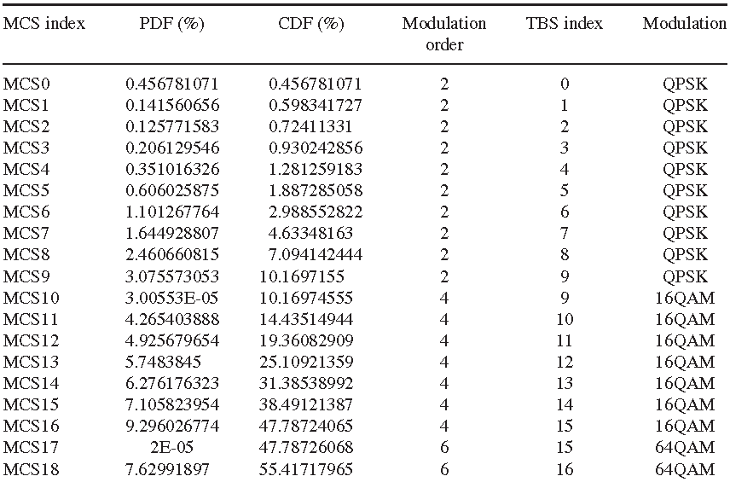
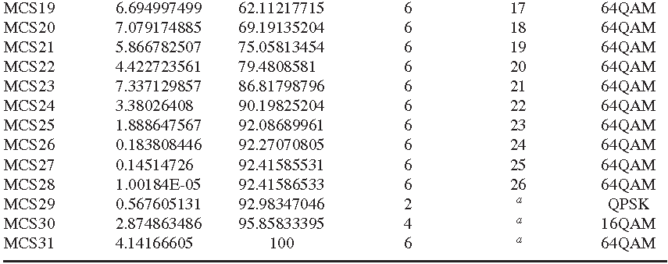
LTE Radio Interface: Modulation and Coding Scheme and Link Adaptation
The Link Adaptation is mandatory to:
Select the optimum MCS according to the channel conditions and UE capability
Guarantee performance metrics such as data rate, packet error rate, and latency
The AMC is the most famous link adaption technique where various MCSs can be adopted, based on the channel conditions
The users near to the eNB with high SINR values will be assigned a higher MCS and the assigned MCS will be decreased as the user moves away from the eNB as the SINR is degraded and the interference is increased
The same MCS should be applied to all groups of RBs scheduled to one user within one TTI by a single antenna stream
Based on the reported CQI, the eNB scheduler selects the MCS assigned to the user
The 3GPP standard allows MCS indices of 0–31
The MCS range 0–9 allows QPSK modulation
The MCS range 10–16 allows 16QAM modulation
The MCS range 17–28 allows 64QAM modulation
The MCS range 29–31 allows special operation during retransmissions
PDF and CDF of MCS DL and corresponding modulation and TBS for PDSCH

Slide 17
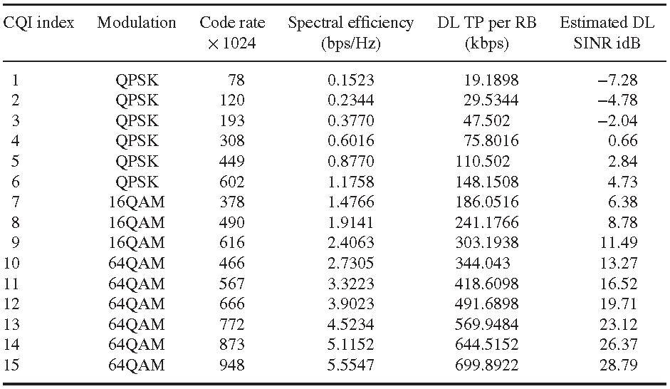
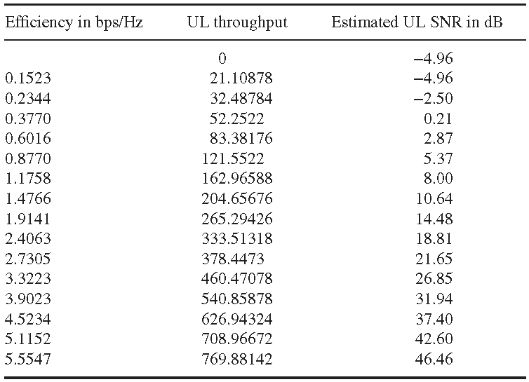
LTE Radio Interface: Channel Quality Indicator
The Channel Quality Indicator (CQI) index indicates a suitable DL transmission data rate, that is, a suitable MCS value
The CQI is a 4-bit integer and is based on the observed DL SINR at the UE.
The CQI estimation considers the UE capability in terms of number and type of receiver used for detection in order for the eNB to select an optimum MCS level for the transmission
The reported CQI indices are used by the eNB for DL scheduling and link adaptation
CQI is carried by PUCCH or PUSCH depending on the situation as follows:
Carried by PUCCH : When there is no UL data to be transmitted
Carried by PUSCH : When there is UL data to be transmitted.
UE computes SINR on each RB, converts it to CQI and reports it to eNB where it is used to select the most suitable MCS for user data transmission in particular RB. SINR value defines the MCS to be used for a RB
DL CQI Table
UL CQI Table
3GPP (2011) LTE Release 10 - Physical Layer Procedures. TS 36.213V 10.1.0

Slide 18
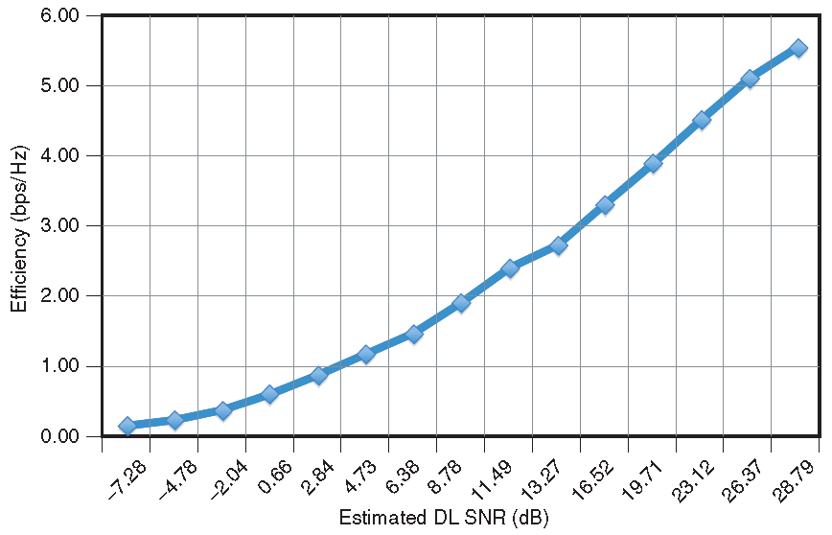

LTE Radio Interface: Channel Quality Indicator
The spectral efficiencies and throughput per RB in kbps for DL and UL versus the estimated SINR is shown in Figure A and Figure B
The graphs represent the minimum performance of PDSCH and PUSCH channels
It is recommended to use the vendor-specific curves during link budget estimation
Obtaining these curves from field measurement will allow the operator to evaluate the vendor performance versus 3GPP minimum performance
These curves are key criteria to benchmark the network vendor’s performance
Fig. A. Spectral efficiency and corresponding throughput per RB versus DL SINR
Fig. B. Spectral efficiency and corresponding throughput per RB versus UL SINR

Slide 19
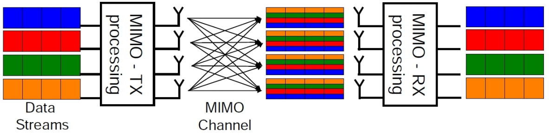
LTE Radio Interface: MIMO
One of the important technologies used in LTE downlink is MIMO (Multiple-Input Multiple-Output)
In MIMO systems, independent parts of a data block are sent over uncorrelated antennas
With a minimum distance greater than e.g. 10λ to ensure uncorrelatedness
The number of transmit and receive antennas can vary from 1 to 4
For example a 4x4 system MIMO has four TX and four RX antennas
MIMO exploits the independency of the scattered signal components in a radio channel und makes some data rate gain possible
The greater the independencies between different paths in a channel with scattering, the higher the achieved data rate gains

Slide 20
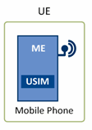
LTE Radio Interface: User Equipment
The mobile device in LTE is termed the User Equipment (UE) and is comprised of two distinct elements:
Universal Subscriber Identity Module (USIM)
Supports a number of functional entities and protocols including:
RR (Radio Resource)
This supports both the control and user planes
It is responsible for all low level protocols including RRC, PDCP, RLC, MAC, and PHY layers
The layers are similar to those in the eNB protocol layer
EMM (EPS Mobility Management)
Is a control plane entity which manages the mobility states of the UE: LTE idle, LTE active, and LTE detached
Transactions within these states include procedures such as TAU (tracking area update) and handovers
ESM (EPS Session Management)
Is a control plane activity which manages the activation, modification, and deactivation of EPS bearer contexts (can either be default or
dedicated EPS bearer contexts)
The Mobile Equipment (ME)

Slide 21
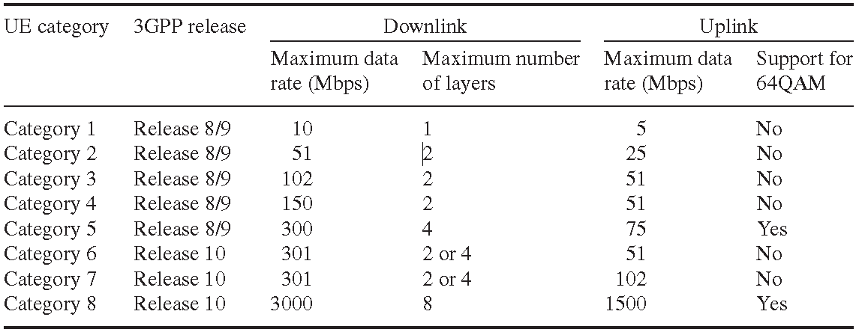
LTE Radio Interface: User Equipment
The PHY layer capabilities of the UE may be defined in terms of the frequency bands and data rates supported.
Devices may also be capable of supporting adaptive modulation including QPSK, 16QAM, and 64QAM
The UE is able to support several scalable channels, including 1.4, 3, 5, 10, 15, and 20 MHz, while operating in FDD and/or TDD
The UE may also support advanced antenna features such as MIMO with a different number of antenna configurations
The PHY layer and radio capabilities of the UE are advertized to EPS at the initiation of the connection with the eNB in order to adjust the radio resources accordingly
An LTE capable device advertizes one of the categories according to its software and hardware capabilities
LTE UE categories

Slide 22
www.teleworx.com

